Slide 1
Continuous Delivery with IBM Cloud
William Pereira
z/OS System Programmer | Cloud Technology enthusiast

Slide 2
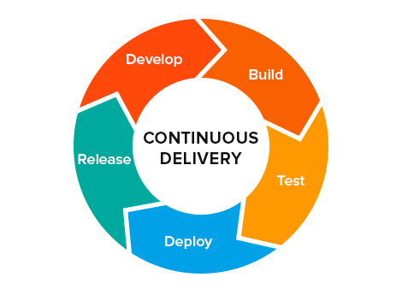
The problem of delivery software
How to delivery a good Idea as quickly as possible?

Slide 3
Ingredients
Automate
Build
Deploy
Tests
Configuration Management
Servers
Scripts
Databases
DevOps Culture
Continuous Integration

Slide 4
CI/CD Process

Slide 5
Hands On

Slide 6
Setup your machine
Install NodeJS
https://nodejs.org/en/
Install VSCode
https://code.visualstudio.com/
Install Docker
https://www.docker.com/get-started
Install Git
https://git-scm.com/

Slide 7
The project
Agenda App
Repository
https://github.com/billpereira/RTE-2019-Agenda-App

Slide 8
Setting up the Dockerfile

Slide 9
Linking with Travis

Slide 10
Setting Up IBM Toolchain

Slide 11
Making changes on the application and re-deploying

